Slide 1
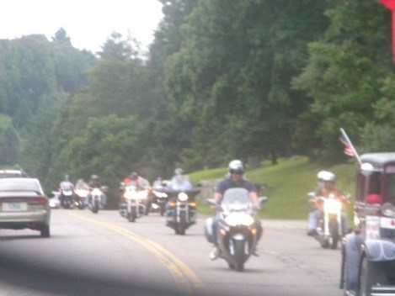
Ride With A Purpose MOTORCYCLE AND CLASSic car July 12, 2014 8am-2pm Rides starting in Burlington, Newport, Rutland, Merging at Barre PLANNED PARENTHOOD ABORTION CENTER and riding together to the State House, followed by a luncheon on the State House lawn. PRAYER LOCATIONS · Burlington · Newport · Rutland · Hyde Park · Barre · Montpelier VRLC@vrlc.net OR 802.229.4885
6th ANNUAL VERMONT
RIDE FOR LIFE
All Ages Event
SUGGESTED DONATION
$25 PER BIKE
SPONSOR A RIDER OR CAR
DONATE DIRECTLY TO VRLC.NET/DONATE SPECIFY VRLC-ED FUND FOR TAX DEDUCTIBLE GIFT
PO Box 1079
Montpelier, VT 05601
Benefiting
VERMONT RIGHT TO LIFE EDUCATIONAL TRUST~VRLC EXISTS TO RESTORE LEGAL PROTECTION TO THOSE MEMBERS OF THE HUMAN FAMILY WHO ARE THREATENED BY ABORTION, INFANTICIDE AND EUTHANAS IA.

